Slide 1
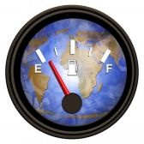
Performance Dashboards
Driving Your Agency’s Success
Presented by: Mary E. McEneany, Chief Financial Officer
NIQCA Conference, October 22, 2008

Slide 2

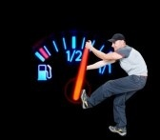
What is a “Performance Dashboard”?
A combination of software, data and technology designed to give you “at a glance” information on strategic initiatives, projects, or processes.
From the general to the specific - A tool for every level of the organization

Slide 3
What is a “Performance Dashboard”?
A blossoming field to help you monitor, measure, analyze and manage your agency’s “exceptions” based on Key Performance Indicators that YOU identify and develop.
Gets only the information NEEDED to those who NEED it to make the day-to-day, month-to-month, or year-to-year organizational decisions

Slide 4
Why do “Performance Dashboards”?
To provide focus
To give flesh to “mission”
To “globalize” strategic initiatives
To reinvigorate and challenge staff
To integrate and involve IT
To examine and solve exceptions
To provide new tools
To create audit trails

Slide 5
Performance Dashboards
What Questions to Ask?
Do I have the personnel/time/interest to do this right?
What additional investments am I able to make? (IT, Staff Time)
How do I want the “Dashboard” to appear for Board Members, Executives, Managers, Staff ?
What should my first “Dashboard” look like – project, process, initiative?
What’s bothering me?
What do I hope to achieve
What do I want to measure?
How do I want to aggregate the data?

Slide 6
Creating a Performance Dashboard
Key Performance Indicators
Those critical factors that measure and describe what “success” looks like.
Employee Evaluation
Internal Processes
Project
Initiatives

Slide 7
Key Performance Indicators
Mission/Vision/Values
Strategic Initiatives & Issues
Financial results
Customer Satisfaction
Professional Development
Internal Processes
Staff Satisfaction
Community & Environment
Key Result Indicators
Key performance Indicators

Slide 8
Key Performance Indicators
Financial Performance
- FYE surplus
- improvement in cash flow
- collection of fees
- workplace safety
- ease of use
- confidence

Slide 9
Key Performance Indicators
Customer Satisfaction
- Response time
- agency recognition
- quality service
- materials/direction
- confidence/reputation

Slide 10
Key Performance Indicators
Professional Development
- project opportunities
- internal leadership
- promotional opportunities
- learning & growth
- confidence

Slide 11
Key Performance Indicators
Internal Processes
- successful project completion
-employee performance evaluation
- technology integration
- availability of resources
- caseload

Slide 12
Key Performance Indicators
Staff Satisfaction
- key employee retention
- increased recognition
- open decision making
- work environment
- confidence

Slide 13
Key Performance Indicators
Community & Environment
- employment factors
- working relationships
- reputation
- waste management
- confidence

Slide 14
Performance Dashboards in Use
At the Dana-Farber Cancer Institute a constantly updated
dashboard on an internal Web site looks like a notebook,
with tabs pointing viewers to 180 pieces of information that
an be used to monitor the finances, fund raising, patient care,
nd other operations of the $600-million cancer hospital and
research institute.
Miriam's Kitchen, a much smaller Washington group that serves homeless
people, created a "management dashboard" with about two dozen sets of
statistics that its executive director and the governing board review
monthly.
decisions, she says.
At Kaboom, a non-profit that makes and installs children’s playgrounds, they use a dashboard, accessible on the ED’s computer that is filled with colored graphs, charts, and tables that allow her access to both broad and detailed measures of Kaboom's progress and efficiency.

Slide 15
The Dashboard for You
Strategic – lets executives chart progress toward achieving strategic objectives
Operational – Enable front line staff and supervisors to track core operational processes
Tactical – help managers to analyze department activity, processes and projects

Slide 16
The Dashboard for You
- % of days lost to sick time
- % of parent fees collected within (timeframe)
- Workers’ Comp claims/injury – lost time due to injury
- revenue/expense monitoring
- customer service standards
- enrollment monitoring
- caseload performance
- fundraising costs/activities

Slide 17
Performance Dashboards in Use
What do I need to get started?
Pilot project (start small)
Good, accessible data
Technology that is interactive and accessible (web-based)
Committed management and team
Knowledgeable IT staff

Slide 18
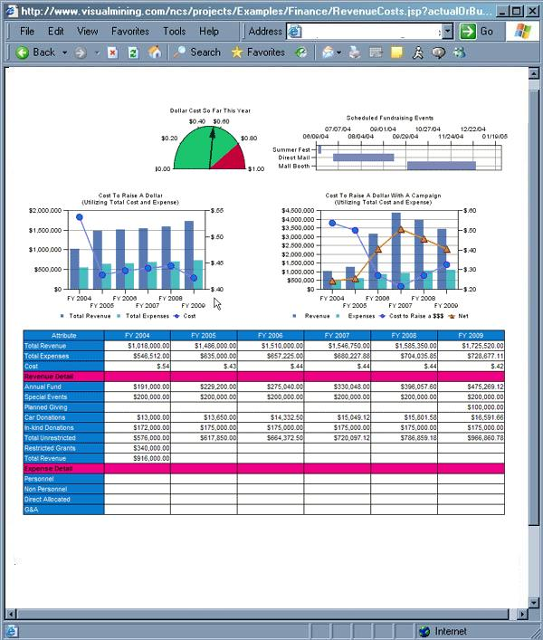
Dashboard Examples
Financial Performance
Financial managements at a Glance
Revenue vs. Expense

Slide 19
Dashboard Examples
Fundraising

Slide 20
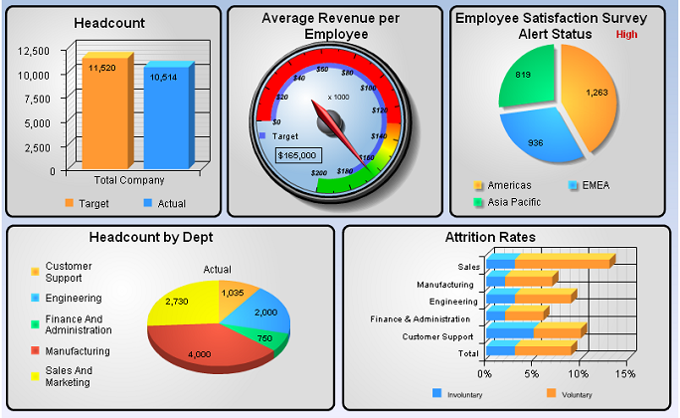
Dashboard Examples
HR

Slide 21
Performance Dashboards
Exercise/Homework

Slide 22
Other Resources
Books
The Nonprofit Dashboard: A Tool for Tracking Progress, BoardSource
The One Page Business Plan for Non-profits, James Horan, Jr.
Key Performance Indicators, by David Parmenter
Performance Dashboards, by Wayne Eckerson
mmceneany@communityaction.us
(413) 376-1126

Slide 23
Performance Dashboards
The Road Ahead

